Slide 1
Loan Application Management System
An In house production by
Team 7 of group 4

Slide 2
01
Tech stack
02
04
05
ReactJS, Bootstrap and Material UI
For the frontend
Java Spring REST /Spring Boot (JPA)
The backend framework
Maven
03
Java Build Manager
MariaDB + MySQL
Database management system
Spring Security JWT
For added security of REST APIs
JUNIT and Mockito
06
Integration and Unit testing

Slide 3
Motivation
Build an interactive user interface with which a user can easily access and view the requested data
Securing data exchange using Spring Security 3 features such as JWT authentication
1
UI
2
Backend
3
JWT
4
Testing
Ensure the proper connection of all components and their counterparts in the database and enable the user to perform standard CRUD operations effectively
Unit testing using JUNIT
Integration testing using Mockito

Slide 4
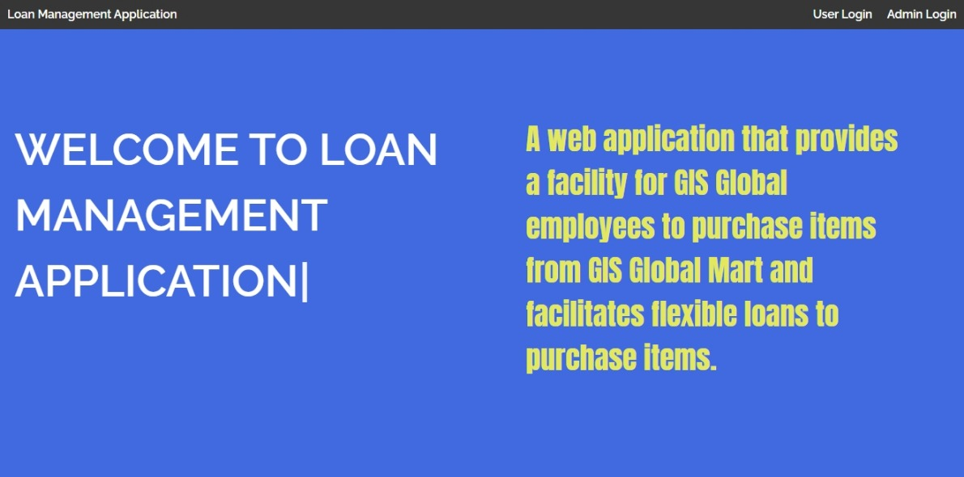
Frontend

Slide 5
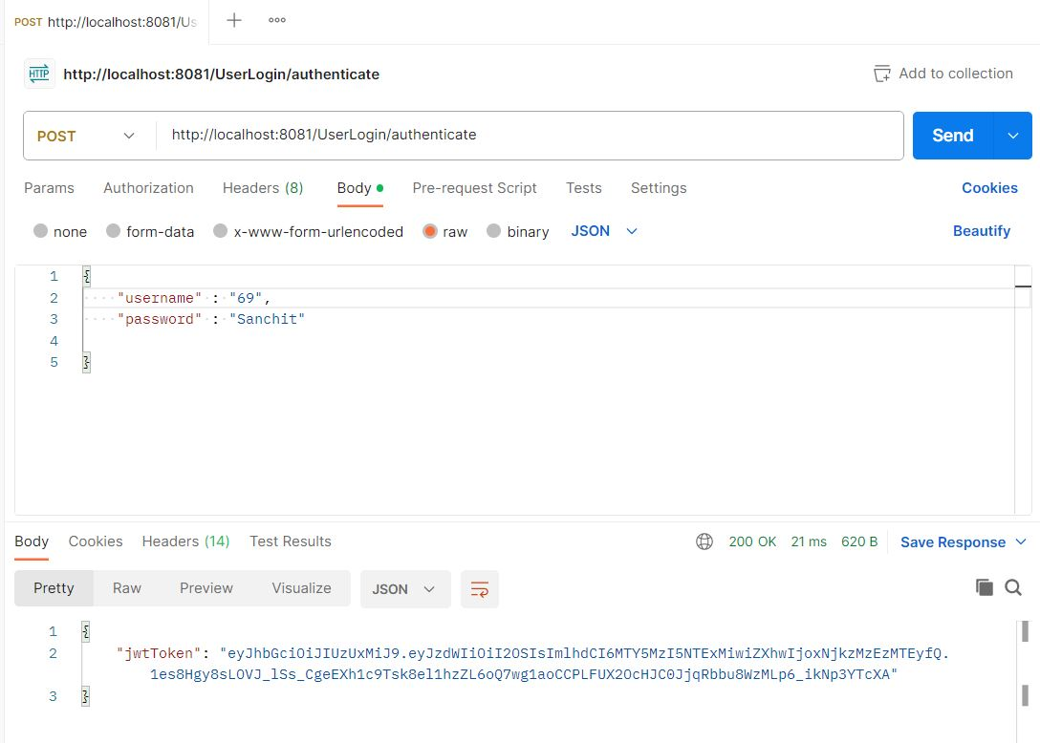
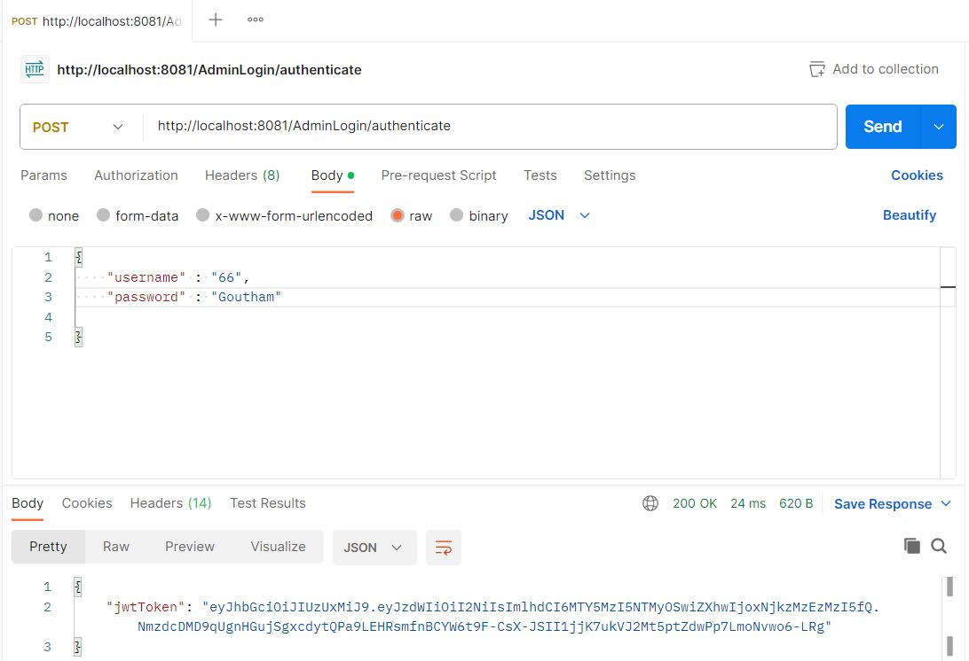
Postman GET/POST/PUT testing for API endpoints
User Login Authentication
Admin User Authentication

Slide 6
Database tables
Employee Card Details
Loan_id (Primary)
Card_issue_date
Employee Issue Details
Issue_id (Primary)
Employee Master
Employee_id (Primary)
Date_of_birth
Item Master
Loan Card Details
Employee_id
Issue_date
Return_date
Employee_id
Item_id
Date_of_joining
Department
Designation
Employee_name
Item_id (Primary)
Issue_status
Item_category
Item_cost
Item_description
Item_make
Loan_id (Primary)
Duration_in_months
Loan_type
User Login Details
Employee_Id (Primary)
Password
Is_admin

Slide 7
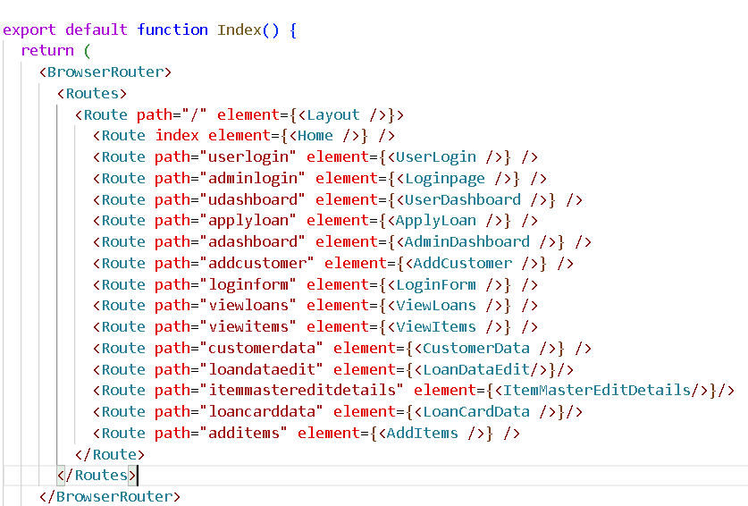
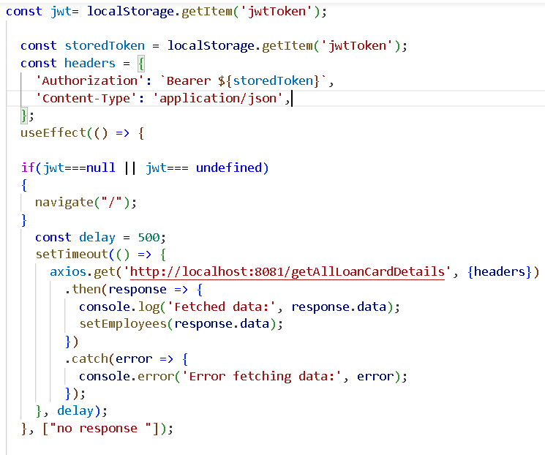
Flow of control in program : Frontend
Index.js contains all the components and it renders them when the particular endpoint is accessed.
The respective components perform specific functions and communicate with the backend APIs for validation, fetching and sending data.

Slide 8
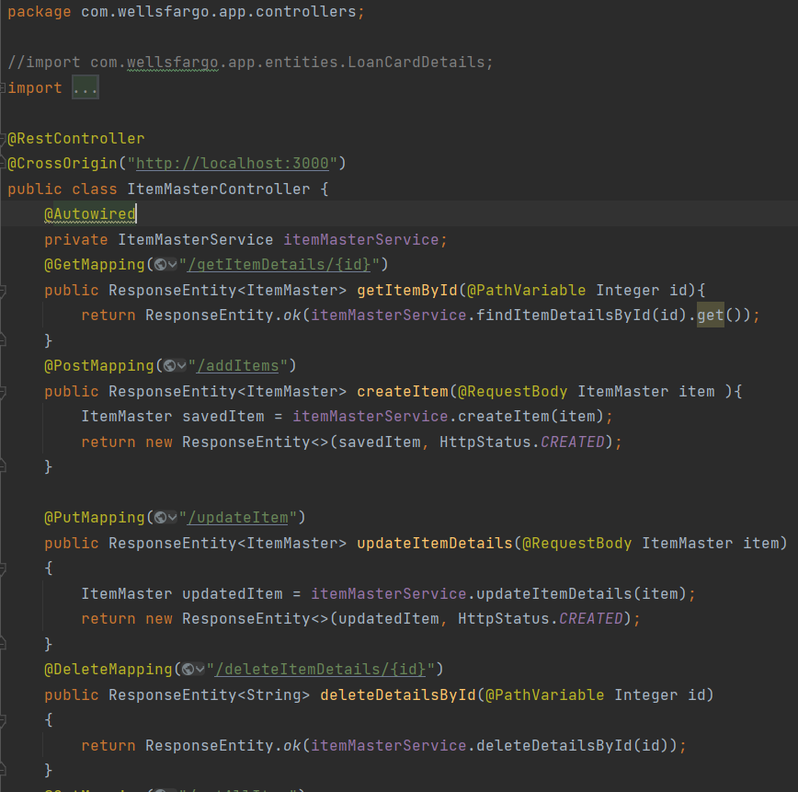
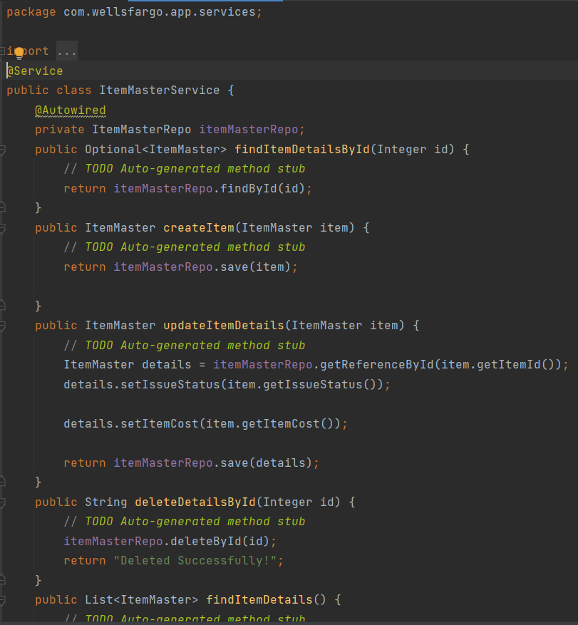
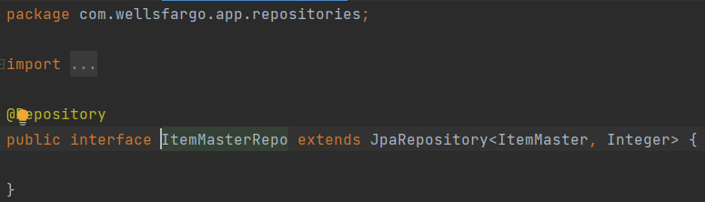
Flow of control in program : Backend
Request
Request
Request
Request
Web App
Controller
Service
Repository
Database
Response
Response
Response
Response

Slide 9
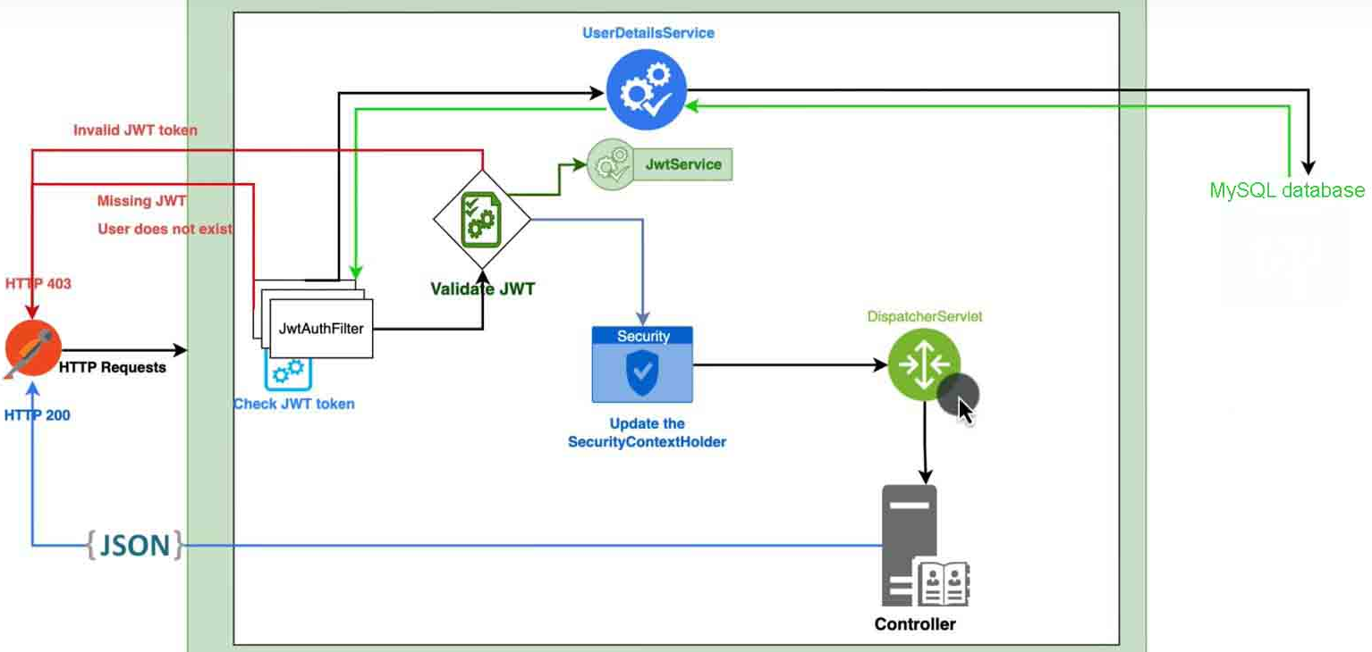
JWT Authentication : Working principle
Image source : https://www.youtube.com/watch?v=KxqlJblhzfI

Slide 10
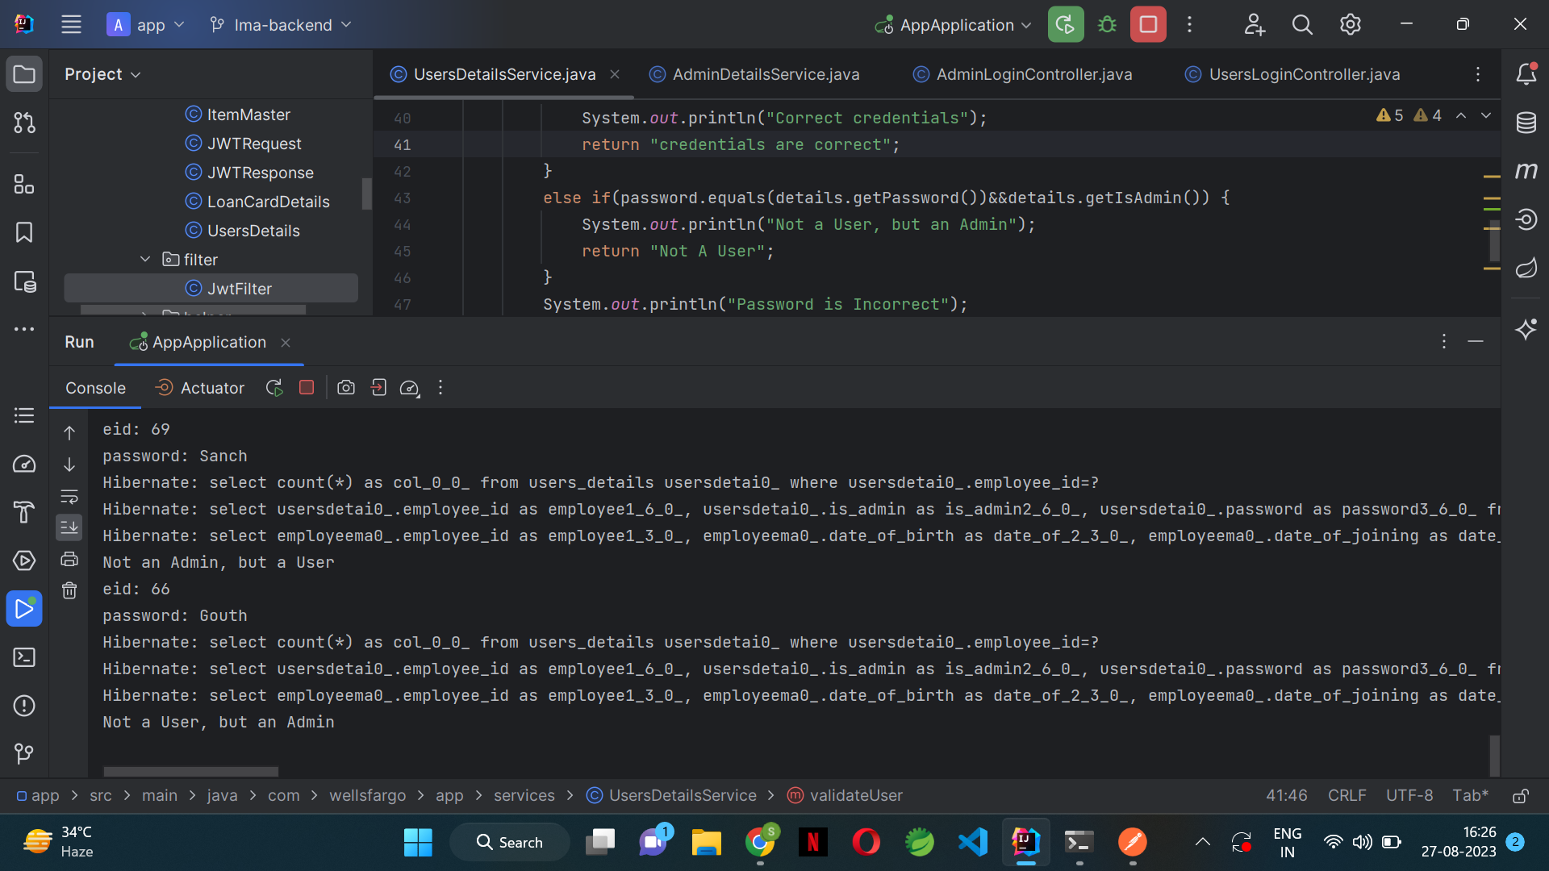

JWT Authentication

Slide 11
Testing

Slide 12
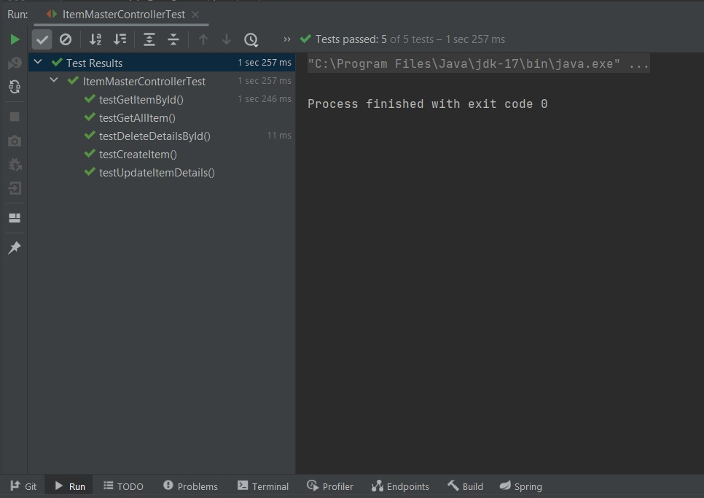
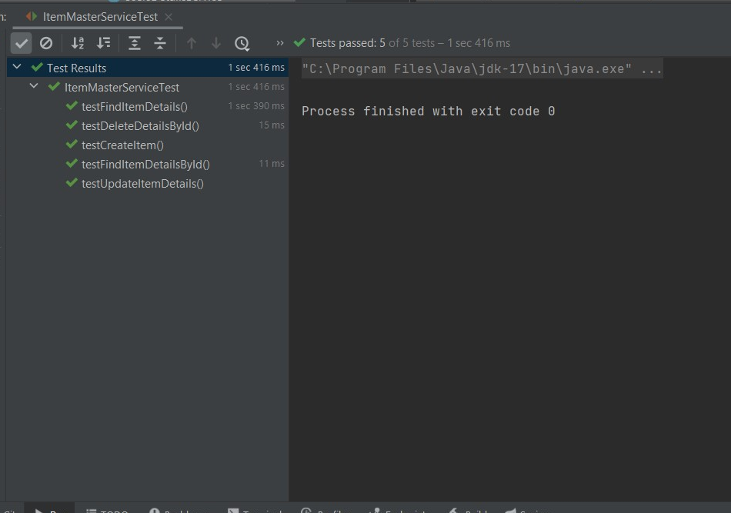
Item Master Controller test
Item Master Service test

Slide 13
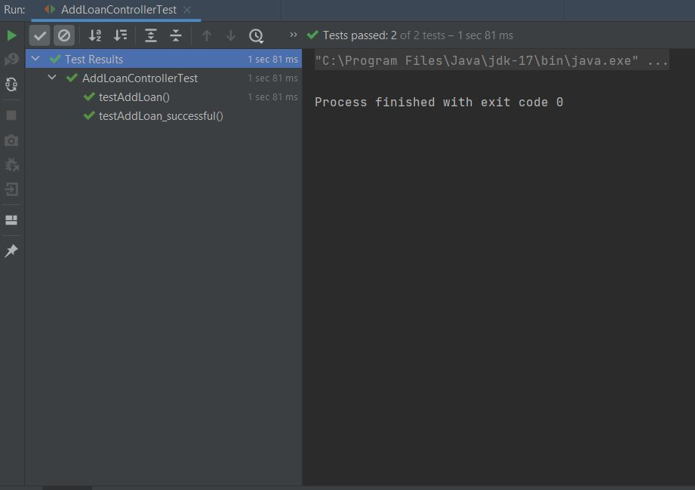
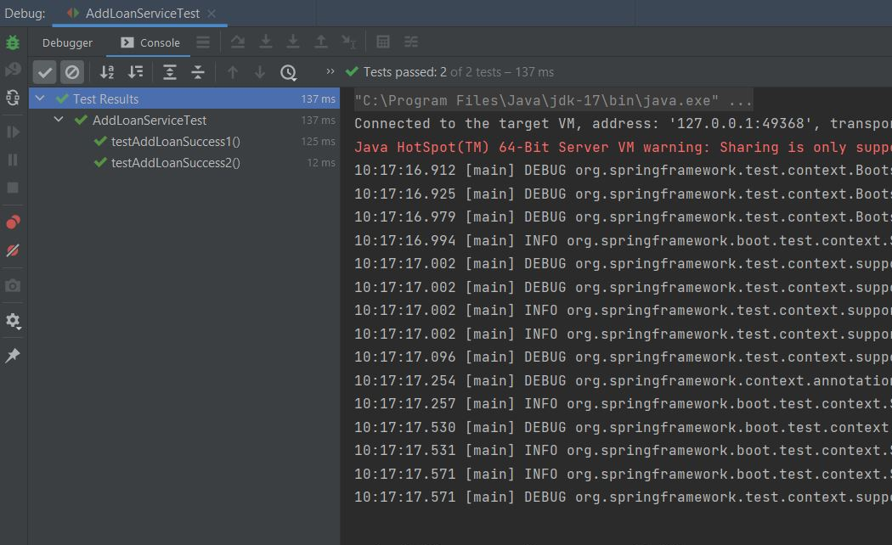
Add Loan Controller Test
Add Loan Service Test

Slide 14
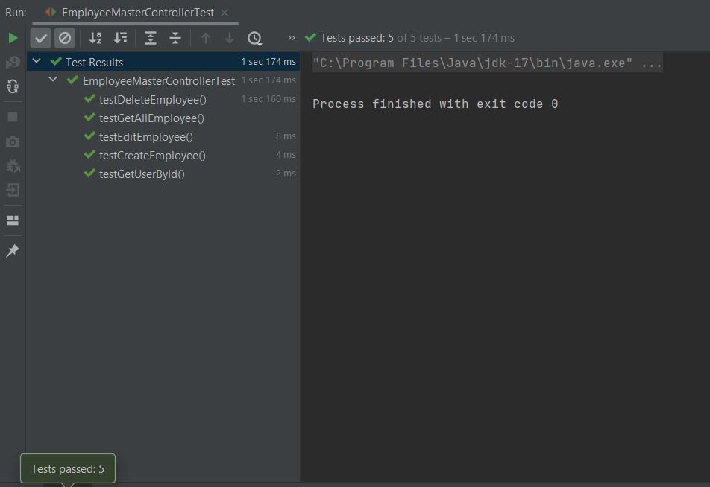
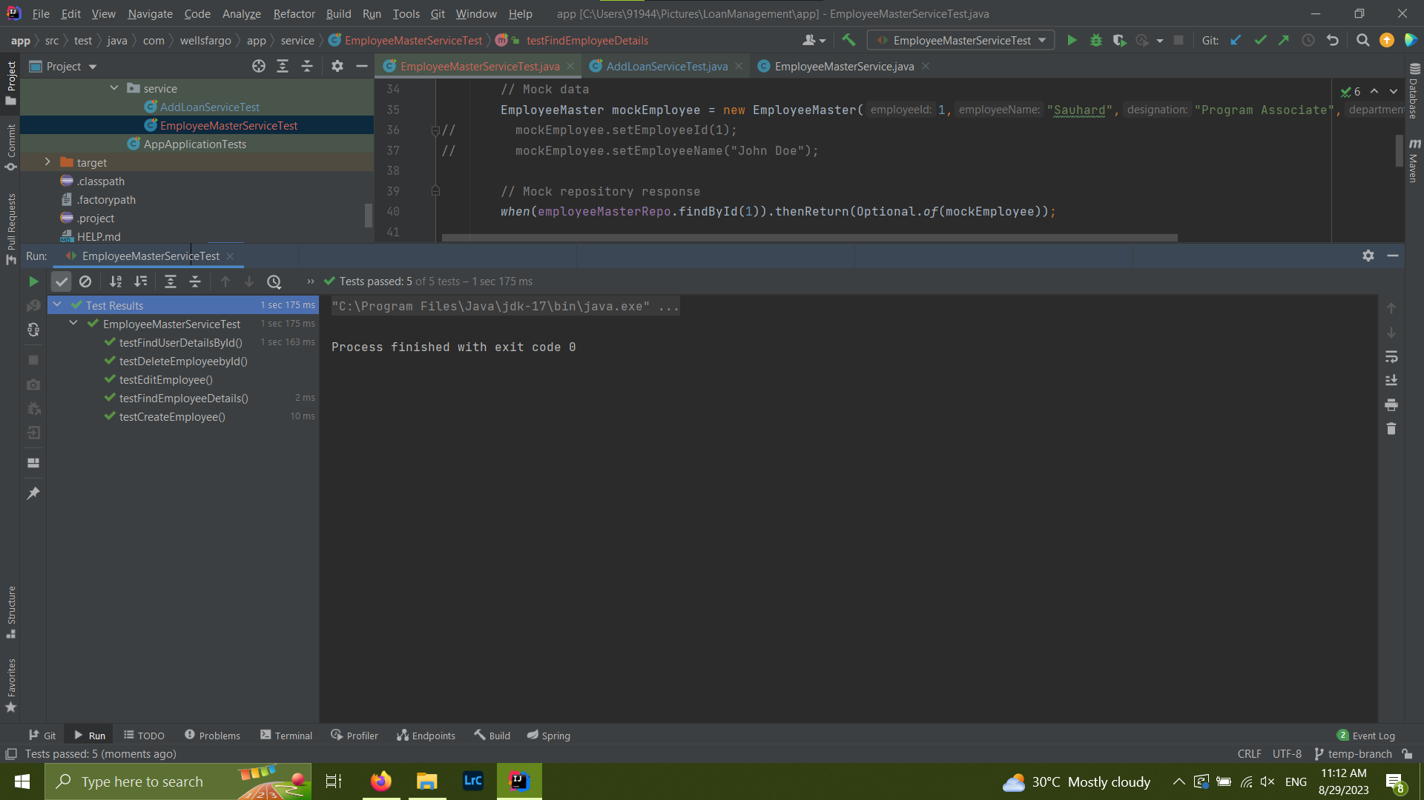
Employee Master Controller Test
Employee Master Service Test

Slide 15
Deployment
UI Improvement
What needs to be done next?
Deploying the web application using cloud hosting services
Enhancing the look and feel of the UI pages and making the pages responsive.

Slide 16
Thank you!
The team :
Sanchit Chakraborty
Kabilan Hussain
Yashaswini Sharma
Sauhard Pareek
Goutham S Lal
Wells Fargo International Solutions, Chennai

